Slide 1
Advanced Data Structure
Xu Yanyan

Slide 2
Advanced Data Structure
Disjoint set (union-find set or merge-find set)
Segment Tree

Slide 3
Disjoint set
A data structure that stores a collection of disjoint (non-overlapping) sets.
Provide operations for merging sets (replacing them by their union), and finding a representative member of a set.
Applications
Kruskal's algorithm (greedy + disjoint set)
The number of connected components in an undirected graph (Leetcode #323)

Slide 4
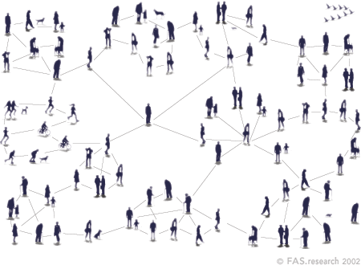
Background—Gang
There are n people in a city and they belong to different gangs.
Given the relationships between these people (For example, No. 1 and No. 2 are friends, and No. 1 and No. 3 are also friends. Then they belong to the same gang), compute how many gangs there are and which gang each belongs to.
Using disjoint set.

Slide 5
Operations of the disjoint set
Initialization
Merging (sets)
Finding (the representative member of a set)

Slide 6
1. Initialization
Define “int s[]” as the disjoint set.
Initialize s[i]=i. “one person one gang”
Someone’s number is i, and he belongs to the gang s[i].

Slide 7
2. Merging
Adding the first relation (1, 2)
Node 1 is merged into the set of node 2, that is, the value of s[1] is changed to the value of s[2].

Slide 8
Adding the second relation (1, 3)
Find s[1] of node 1, which is 2, and recursively find s[2] of node 2 is 2;
Merge the set of node 2 and the set of node 3. Now, nodes 1, 2, and 3 belong to the same set.

Slide 9
Adding the third relation (2, 4)
Really far away from the leader

Slide 10
3. Finding
Finding the representative member of a node is a recursive process. Until s[i] is equal to i, the set of the root node is found.
This finding tree, which may be very deep, with a complexity of O(n) of finding, may degenerate to a linked list.

Slide 11
void init_set(){ // initialization
for(int i = 1; i <= maxn; i++)
s[i] = i;
}
void union_set(int x, int y){ // merging
x = find_set(x);
y = find_set(y);
if(x != y) s[x] = s[y]; // or s[y] = s[x];
}
int find_set(int x){ // finding recursively
return x==s[x]? x:find_set(s[x]);
}

Slide 12

How many sets (gangs)?
“s[i] = i” means i is a root node, and it is the representative member of the set including it (leader);
The number of root nodes is the number of sets.

Slide 13
Complexity
union_set() & find_set(), the depth of the tree, O(n)
Poor performance
Optimization?
<=O(logn)

Slide 14
Optimization of Merging
When merging x and y, find their roots first;
Merge the lower tree to the higher tree according to their heights.

Slide 15
int height[maxn]; // height[i], the height of i
void init_set(){
for(int i = 1; i <= maxn; i++){
s[i] = i;
height[i]=0; // initialize heights
}
}
void union_set(int x, int y){ // optimize merging
x = find_set(x);
y = find_set(y);
if(x==y) return;
if (height[x] == height[y]) {
height[x] = height[x] + 1; // merge, height+1
s[y] = x;
}
else{ // merge the lower tree to the higher tree; the
// height of the higher tree doesn’t change
if (height[x] < height[y]) s[x] = y;
else s[y] = x;
}
}

Slide 16
Optimization of finding--Path compression
find_set(): Find the root node along the path, which may be very long. TLE
Optimization: When returning along the path, change the values to the root node.
When finding next time, the complexity is O(1).

Slide 17
Path compression (recursively)
int find_set(int x){
if(x != s[x])
s[x] = find_set(s[x]); //path compression
return s[x];
}
Path compression not only optimizes the finding, but also optimizes the merging, because finding is used when merging.

Slide 18
Path compression (iteratively)
To avoid stack overflow (for huge data size):
int find_set(int x){
int r = x;
while ( s[r] != r ) r=s[r];//finding the root
int i = x, j;
while(i != r){
j = s[i];
s[i]= r ; // change to the root
i = j;
}
return r;
}

Slide 19
How Many Tables

Slide 20
More disjoint set problems
poj 2524 Ubiquitous Religions
poj 1611 The Suspects
poj 1703 Find them, Catch them
poj 2236 Wireless Network
poj 2492 A Bug's Life
poj 1988 Cube Stacking。
hdu 3635 Dragon Balls
hdu 1856 More is better
hdu 1325 Is It A Tree
hdu 1198 Farm Irrigation
hdu 2586 How far away

Slide 21
Segment Tree
A Segment Tree is a data structure that allows answering range queries over an array effectively, while still being flexible enough to allow modifying the array.
Include finding the sum of consecutive array elements a[l…r], or finding the minimum element in a such a range in O(logn) time.
Allow modifying the array by replacing one element, or even change the elements of a whole subsegment (e.g. assigning all elements a[l…r] to any value, or adding a value to all elements in the subsegment) in O(logn) time.

Slide 22
Application background
Given a sequence {a₁, a₂, ... , a_{n}} ,
1. Find the maximum/minimum/summation (Query)
For i, j<=n, find the maximum/minimum/summation in {a_{i}, ..., a_{j}}
2. Modify an element
Given k and x, modify a_{k} to x
3. Modify all elements in a subsegment

Slide 23
Brute Force?
Using an array
Minimum/Maximum/Summation Query O(n)
Modify an element O(1)
Modify all elements in a subsegment O(n)
Inefficent
If there are m query & modifying, the complexity is O(mn). （m, n >10⁵，O(mn) > 10¹⁰）

Slide 24
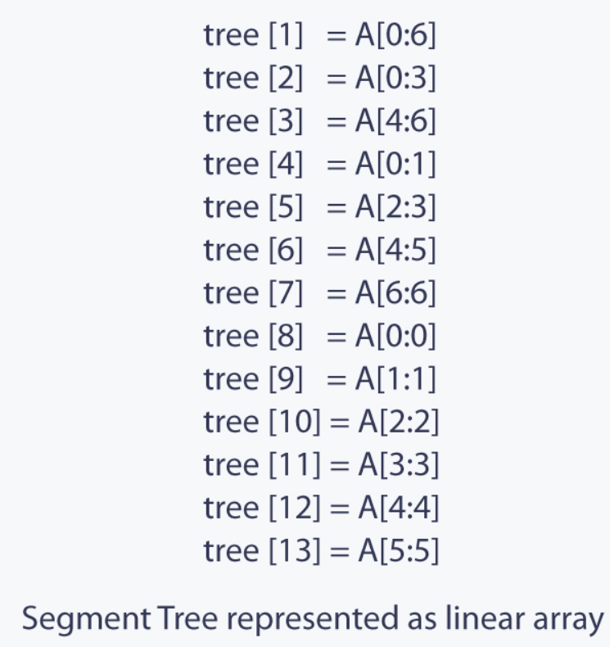
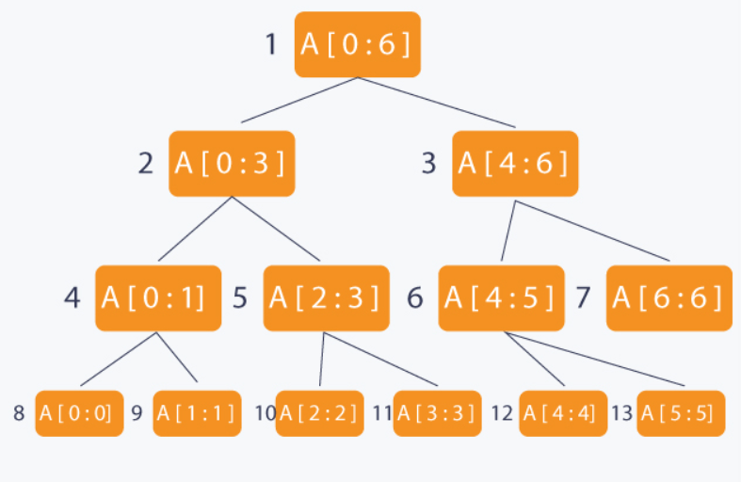
Using segment tree
m query & modifying, O(mlogn)

Slide 25
Definition
A segment tree is basically a binary tree used for storing intervals or segments. Each node in the segment tree represents an interval.
The root of the segment tree represents the whole array A[0:N−1]. Then it is broken down into two half intervals or segments and the two children of the root in turn represent the A[0:(N−1)/2] and A[(N−1)/2+1:(N−1)]. The height of the segment tree is O(logN). There are N leaves representing the N elements of the array. The number of internal nodes is N−1. So, the total number of nodes is 2×N−1.

Slide 26
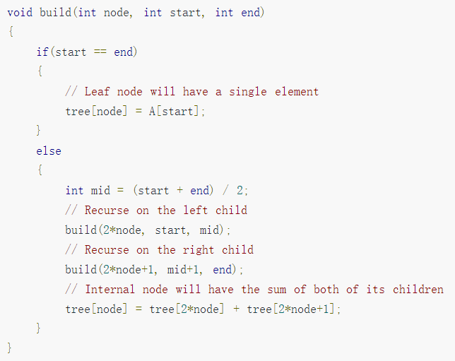
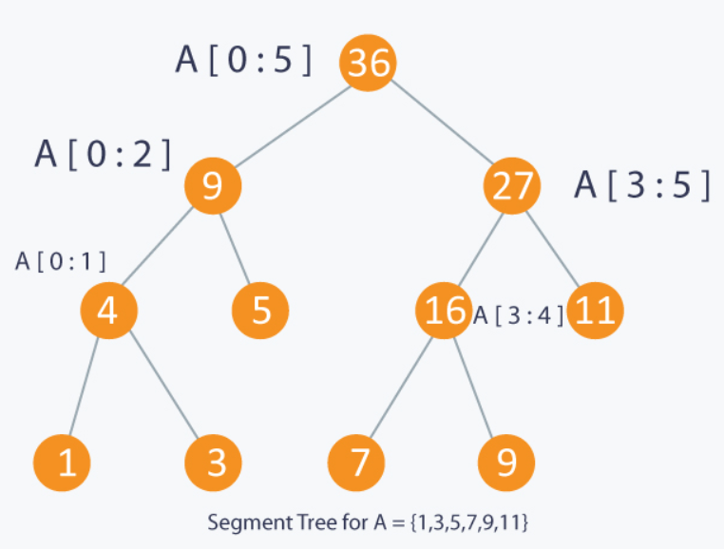
Example--summation
The complexity of build() is O(N).

Slide 27
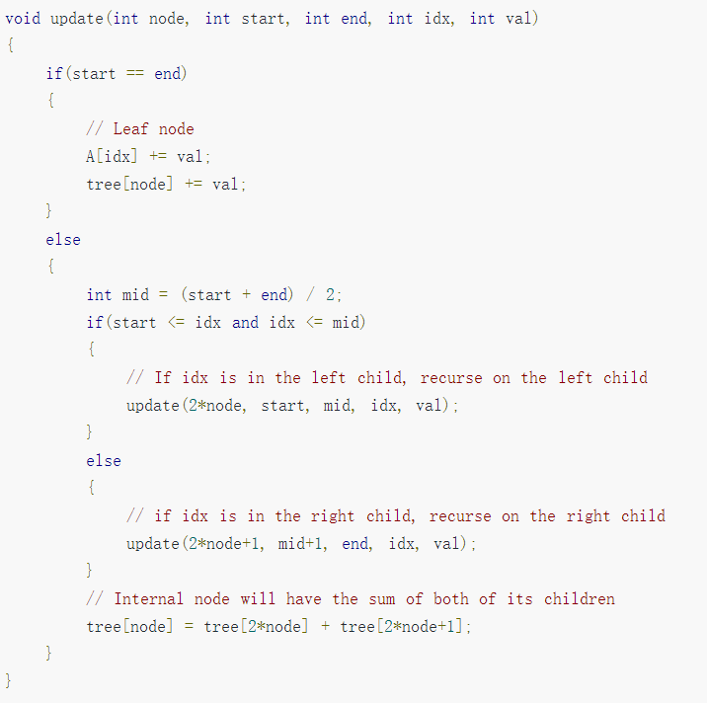
The complexity of update() is O(logN).

Slide 28
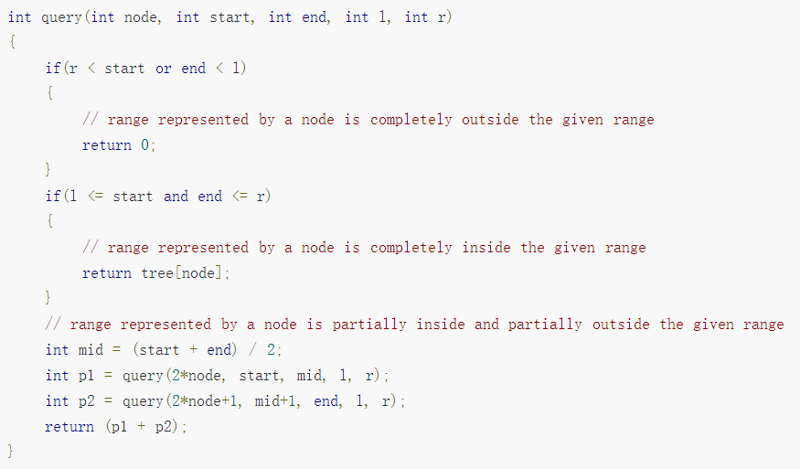
The complexity of query() is O(logN).

Slide 29
Exercise--Minimum
{1, 2, 5, 8, 6, 4 ,3}
{1, 2, 5, 8, 6, 4 }
N = 2^k -> 2N-1
N = 2^k+1 -> 2*2^{k+1}-1=4(N-1)-1≈ 4N

Slide 30
Lost Cows
modifying the array by replacing one element
Sample Input:
0 1 2 1 0 (pre[])
Sample Output:
2 4 5 3 1 (ans[])

Slide 31
pre[] = {0 1 2 1 0} ans[] = {2 4 5 3 1}
1. pre[5]=0 means there are 0 smaller number before ans[5], that is, ans[5] is the smallest. Among 1~5, 1 is the smallest, so ans[5]= 1. The first 4 numbers of ans[] no longer include 1, so the remaining numbers are 2~5.
2. pre[4]=1; among the remaining numbers 2~5, number 3 is the second one in ascending order, so ans[4]=3.
3. pre[3]=2; among the remaining numbers 2,4,5, 5 is the third one in ascending order, so ans[3]=5.
4. pre[2]=1; among the remaining numbers 2,4, 4 is the second one in ascending order, so ans[2]=4.
5. pre[1]=0; the remaining number is 2, so ans[1]=2.
Summarizing the above steps, in each step, among the remaining numbers, the (pre[n]+1)th number in ascending order is ans[n].

Slide 32
Brute force
Calculate backward from the end of pre[]. Each time a number is determined, the remaining numbers need to be re-ranked. The time complexity for re-ranking is O(n);
There are n nubmers, so the total complexity is O(n²).
In this problem, since n< 8000, brute force works.

Slide 33

Using segment tree
Using segment tree to efficiently re-rank the remaining numbers in O(logn)

Slide 34
1. Bulid the tree
The leaf nodes represent the serial numbers of the cows, and the internal nodes mean the serial number ranges (len) of the cows.

Slide 35
2. Query & Update
The first step: pre[5]=0, and compute ans[5]
Starting from the root, recursively find the lower left corner, that is, the node 1, and get ans[5]=1.
Update the 4 passed nodes, that is, len--
The node 1 has been reduced to 0, so it will be excluded in the following steps.

Slide 36
The second step: pre[4]=1, and compute ans[4], which is to find the second number.
Starting frome the node, recursively get ans[4]=3. Update the 3 passed nodes.

Slide 37
Complexity
For each step, starting from the root to the leaf node, at most log₂4n nodes need to be updated, and the complexity is O(logn).
There are n numbers to be processed (n steps), so the total complexity is O(nlogn).

Slide 38
A Simple Problem with Integers
Modifying all elements in a subsegment
Adding a value to all elements in a subsegment

Slide 39
Brute force: The complexity of each C or Q operation is O(n). There are Q operations, so the total complexity is O(n²) (In this problem, Q=n).
Using the segment tree with modifying an element: The complexity of modifying an element is O(logn). For each C operation, there are n times of modifying, so the complexity of C operation is O(nlogn). There are Q operations, so the total complexity is O(n²logn). Worse than brute force!

Slide 40
Key of modifying a subsegment: lazy-tag
Lazy: When modifying an entire subsegment, only the segment interval is modified, and each element in it is not modified. Only when the consistency of this subsegment is destroyed, the change value is passed to the sub-intervals.
Tag: Record the status of the “lazy” interval.
The complexity of each C or Q operation is O(logn). There are Q operations, so the total complexity is O(nlogn).

Slide 41
1. Build()
Take [1,10] as an example. The leaf nodes mean 10 numbers from 1 to 10. The number in the upper right corner of each node is the sum of its sub-intervals.

Slide 42
2. Adding a value to all elements in a subsegment
Example: Add 3 to all elements in [3,6]
To find the interval [3,6] in the subtree, there are two cases: [3,6] interleaves with the subinterval(s), or [3,6] contains the entire subinterval(s).
The subintervals [1,5] and [6,10] are interleaved with [3,6]. Continue to dive deeper into the lower sub-intervals.
[3,6] contains [4,5]. According to the lazy principle, [4,5] is modified as a whole without further deepening, and the subintervals [4, 4] and [5, 5] need not be modified.

Slide 44
More segment tree problems
Easy:
hdu 1166，1394，1698，1754，2795
poj 1195，2182，2299，2828，2352，2750，2886，2777，3264，3468
Medium:
hdu 1540，1823，4027，5869
poj 2155，2528，2823，3225。
Hard:
hdu 1255，1542，3642，3974，4578，4614，4718，5756，4441

Slide 45
Binary Indexed Tree?

